Slide 1

Technology Stack Overview: React.js, Django, MongoDB, and More
| #X%2asdd | @X219xz$$ sdkfj1 | 2kdfh #5xkad | #X%2asdd | @X219xz$$ sdkfj1 | 2kdfh #5xkad | #X%2asdd |
June 6, 2024
| #X%2asdd | @X219xz$$ sdkfj1 | 2kdfh #5xkad | #X%2asdd | @X219xz$$ sdkfj1 | 2kdfh #5xkad | #X%2asdd |

Slide 2
Introduction to Technology Stack
Frontend: React.js, HTML5, CSS3, JavaScript
Backend: Django (Python)
Database: MongoDB
Authentication: JWT and OTP via Third-Party Services
Why Use ReactJS?
Advantages of Google Cloud Hosting
Version Control: Git
Agenda

Slide 3

Introduction to Technology Stack
Modern web development relies on a comprehensive technology stack, including frontend technologies like React.js, HTML5, CSS3, and JavaScript, backend framework Django (Python), and database MongoDB. These technologies are significant for their ability to create dynamic, scalable, and secure web applications. React.js, a leading frontend library, allows developers to build responsive user interfaces. Django, known for its robust backend capabilities, ensures rapid development and high security. MongoDB offers a flexible, scalable database solution. Together, these tools streamline development processes and enhance application performance.

Slide 4
Frontend: React.js, HTML5, CSS3, JavaScript
| #X%2asdd | @X219xz$$ sdkfj1 | 2kdfh #5xkad | #X%2asdd | @X219xz$$ sdkfj1 | 2kdfh #5xkad | #X%2asdd |
React.js is a popular JavaScript library for building user interfaces. Created by Facebook, it is widely adopted for its component-based architecture.
HTML5 provides the structure for web pages, allowing developers to define elements like headings, paragraphs, and links.
CSS3 is used for styling web pages, enabling responsive design, animations, and enhanced visual effects.
JavaScript adds interactivity to web pages, enabling dynamic content updates, form validations, and complex animations.
React.js integrates seamlessly with HTML5, CSS3, and JavaScript to create fast, interactive, and highly responsive web applications.
| #X%2asdd | @X219xz$$ sdkfj1 | 2kdfh #5xkad | #X%2asdd | @X219xz$$ sdkfj1 | 2kdfh #5xkad | #X%2asdd |

Slide 5
Backend: Django (Python)
Django is a high-level Python web framework that promotes rapid development and clean design.
It includes built-in features like ORM, authentication, form handling, and URL routing, reducing the need for third-party dependencies.
Django's scalability is facilitated by its modular architecture, which allows independent development and deployment of components.
The framework offers robust security features, including protections against SQL injection, XSS, CSRF, and clickjacking.
Django's ORM simplifies database operations, supports multiple databases, and enables seamless migrations.

Slide 6
Database: MongoDB
MongoDB uses a document model for data storage, which allows for flexible, schema-less data structures that map directly to objects in most programming languages.
Scalability is a core strength of MongoDB, supporting horizontal scaling through sharding, which distributes data across multiple servers and enables handling of large data volumes.
Chosen over traditional SQL databases for its ability to handle unstructured data and rapid iterative development, making it ideal for modern web applications.
Advantages of MongoDB include faster query performance by storing related data together, seamless schema evolution, and a robust set of indexing options.
MongoDB's platform maturity, extensive community support, and enterprise-grade tools like MongoDB Atlas make it a favorite among developers.

Slide 7

Authentication: JWT and OTP via Third-Party Services
| #X%2asdd | @X219xz$$ sdkfj1 | 2kdfh #5xkad | #X%2asdd | @X219xz$$ sdkfj1 | 2kdfh #5xkad | #X%2asdd |
JWT (JSON Web Tokens)
OTP (One-Time Password)
Enables stateless authentication, reducing server load and improving scalability.
Compact tokens can be passed through URLs, POST parameters, or HTTP headers.
Signed using a secret or a public/private key pair ensuring integrity and authenticity.
Ideal for single sign-on (SSO) and API authentication in RESTful APIs.
Adds an extra layer of security by requiring a one-time password.
Handled by third-party services like Twilio for reliable and timely delivery.
Essential for global applications due to extensive infrastructure of providers.
Used for two-factor authentication (2FA) during user login and transaction verification.
| #X%2asdd | @X219xz$$ sdkfj1 | 2kdfh #5xkad | #X%2asdd | @X219xz$$ sdkfj1 | 2kdfh #5xkad | #X%2asdd |

Slide 8

Why Use ReactJS?
Reusability
Fast Rendering
ReactJS provides developers with reusable components, reducing development effort while maintaining flawless performance. Changes in one section don't affect others.
React's virtual DOM feature allows modifications to be tested first, contributing to app performance and a better user experience.
SEO Friendly
Strong Community Support
React reduces website load time, enhancing SEO. Frameworks like Next.js improve SEO by server-side rendering, reducing the client's processing load.
React has a vast community of developers who contribute to its robustness. Extensive tutorials and active forums ensure developers find solutions quickly.

Slide 9
Advantages of Google Cloud Hosting
High Availability
Google Cloud Platform ensures uptime upwards of 99.99%, backed by a robust Service Level Agreement (SLA). This minimizes downtime and maintains business continuity, crucial for user experience and SEO.
Live Migration of VMs
Google Cloud's live migration feature allows virtual machines to be moved between host machines without downtime. This supports maintenance and upgrades without affecting the availability or performance of applications.
State-of-the-Art Security
Google Cloud leverages advanced security measures including encryption of data in transit and at rest, continuous vulnerability scanning, and compliance with industry standards like ISO 27001 and GDPR.

Slide 10

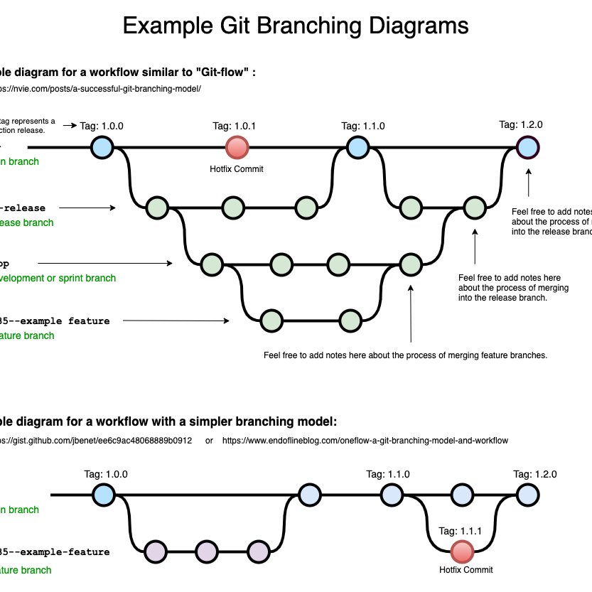
Version Control: Git
Benefits of Using Git
Workflow Flexibility: Offers various branching strategies suitable for different project sizes and team structures, such as GitFlow and trunk-based development.
Speed: Local repositories ensure quick operations without needing to communicate with a server, making it faster than centralized systems.
Reliability: Multiple backups exist as each user has a local repository, making it possible to recover from crashes easily.
Collaborative Features: Easy branching and merging allow team members to experiment and contribute efficiently without affecting the main codebase.

Slide 11

THANK YOU
THANK YOU | THE END | THANK YOU | THE END | THANK YOU | THE END | THANK YOU | THE END | THANK YOU | THE END |
THE END | THANK YOU | THE END | THANK YOU | THE END | THANK YOU | THE END | THANK YOU | THE END | THANK YOU |

